Slide 1


Slide 2

ML BASED CYBER ATTACK DETECTION IN SIMULATED NETWORKS

Slide 3
GROUP MEMBERS INTRODUCTION
Areeba Shafat
BS Computer Science - 8th semester
Abdullah Zubair
BS Software Engineering – 8th semester

Slide 4

INTRODUCTION OF PROJECT
ML Based Cyber Attack Detection in Simulated Networks is a cybersecurity project designed to detect malicious network activities using machine learning. The system works in a controlled simulated network environment where normal and attack traffic is generated, captured, and analysed safely.
Network packets are processed into useful features and classified by trained machine learning models to identify activities such as normal traffic, Ping DoS, SYN Flood, Nmap Scan, and Brute Force attacks. The project also includes live monitoring and a web based dashboard to display traffic status, packet statistics, and detected threats in real time

Slide 5
MAIN COMPONENTS OF THE SYSTEM
Rizwan Riaz Mir
Project Supervisor ┌────────────────────┴────────────────────┐
Abdullah Zubair Areeba Shafat
Configuration, Attack Generation Network Simulation &
ML training Documentation
Detects cyberattacks using machine learning models in a simulated virtual network.
Creates a controlled network environment using GNS3 and VMware Workstation.
Generates both normal and malicious traffic through legitimate user and attacker machines.
Captures and analyzes network packets to identify suspicious or harmful activity.
Provides real-time monitoring through a Flask based web dashboard that displays traffic status, packet statistics, and detected threats.

Slide 6
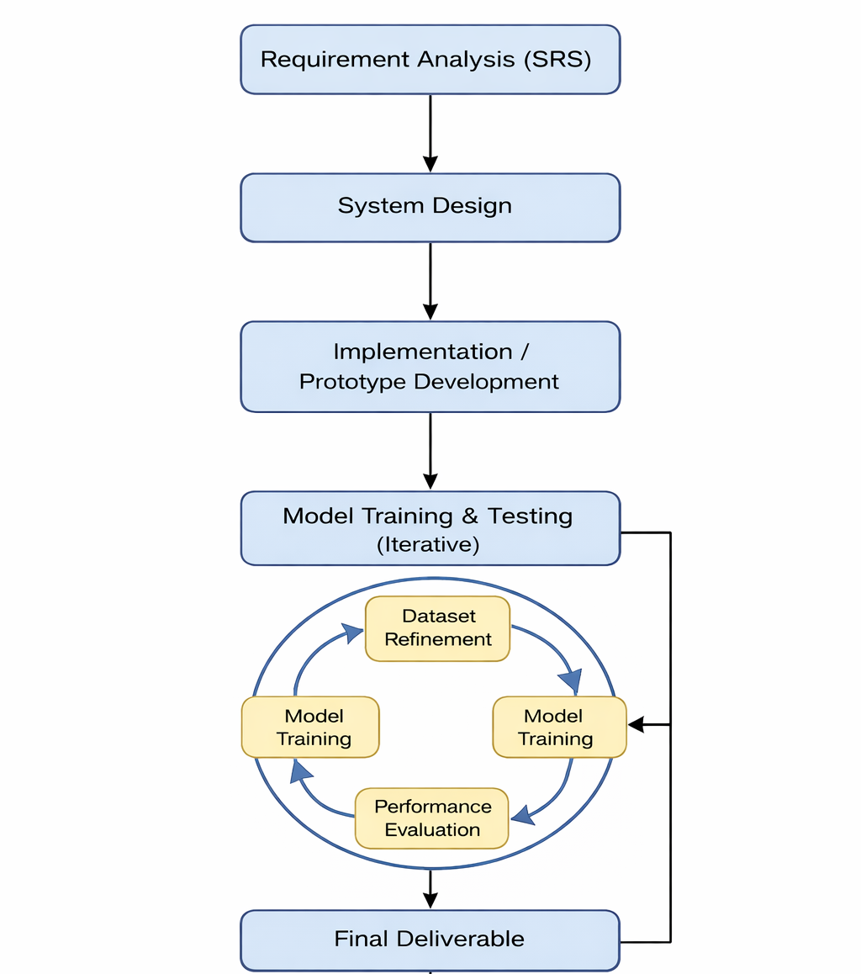
PROCESS MODEL DIAGRAM

Slide 7
ADOPTED METHODOLOGY
Hybrid VU Process Model
(Waterfall + Spiral)
Waterfall Used For:
Software requirement analysis
Software Design
Prototype/implementation
Spiral Used For:
ML model training
Dataset refinement
Performance Evaluation
.

Slide 8
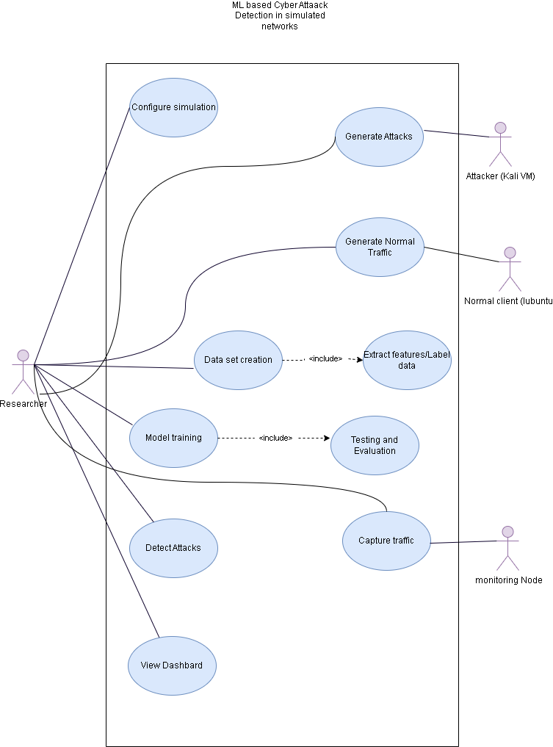
USE CASE DIAGRAM

Slide 9
SOME CORE SEQUENCE DIAGRAMS

Slide 10
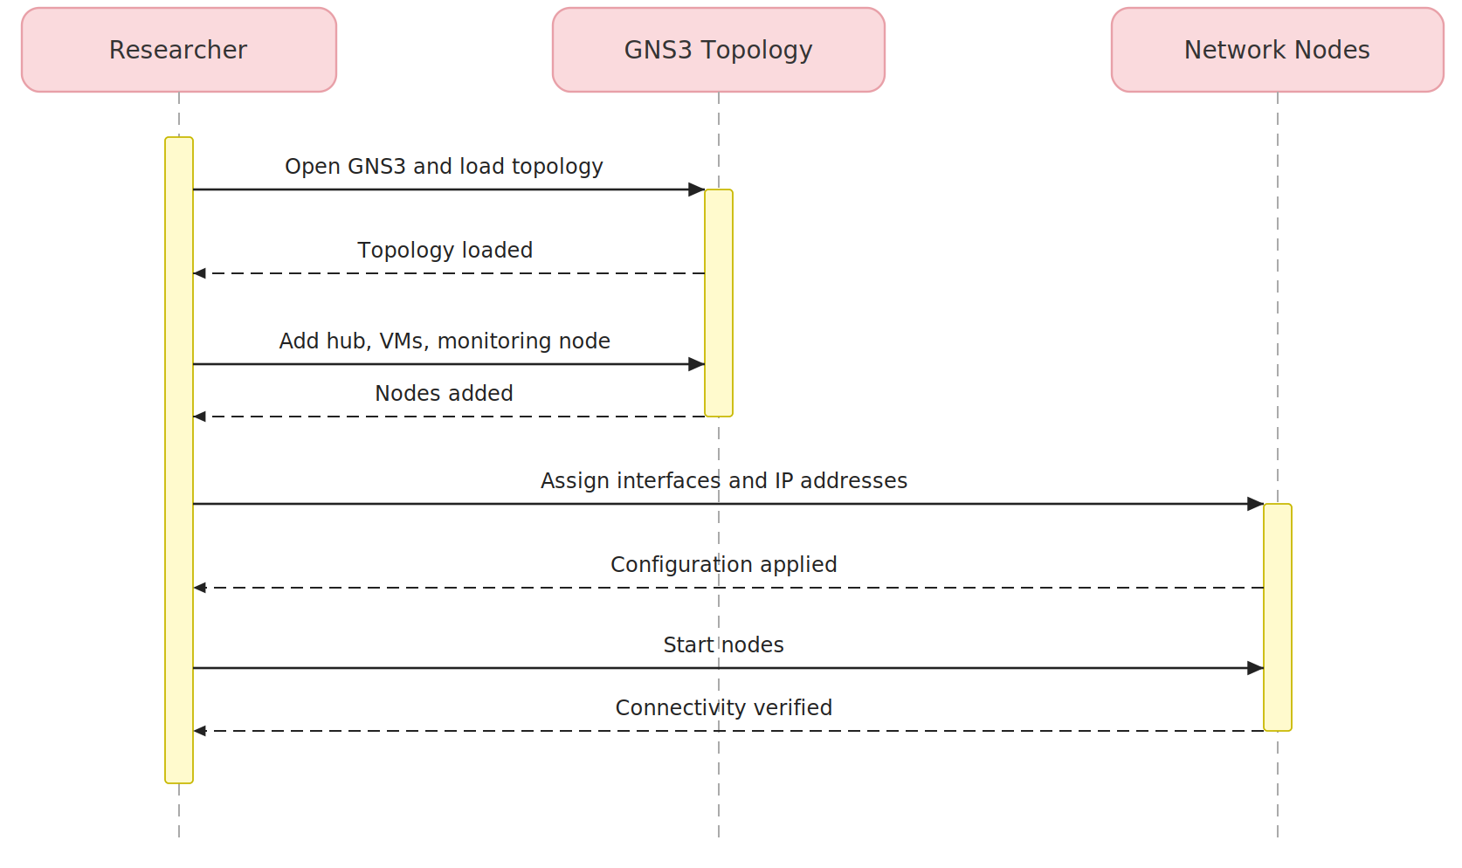
SIMULATION CONFIGURATION

Slide 11
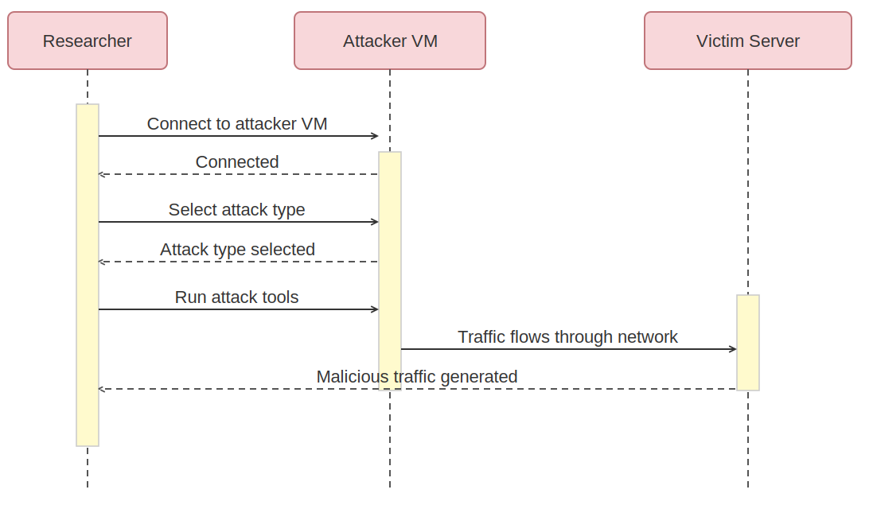
ATTACK GENERATION

Slide 12
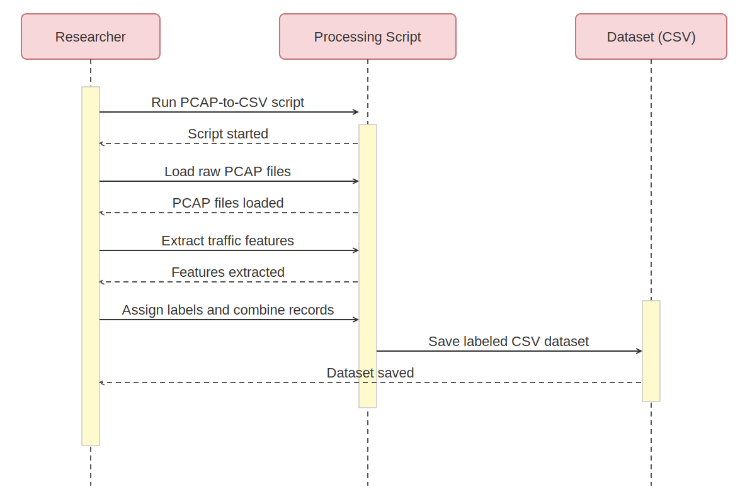
DATASET CREATION

Slide 13
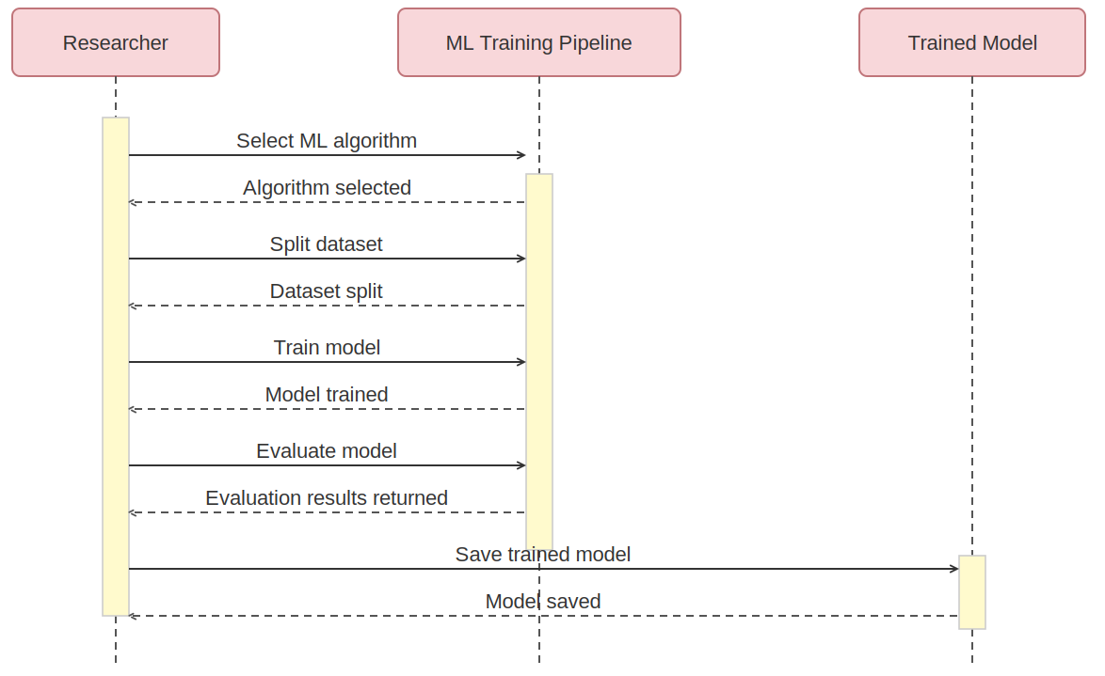
MODEL TRAINING

Slide 14
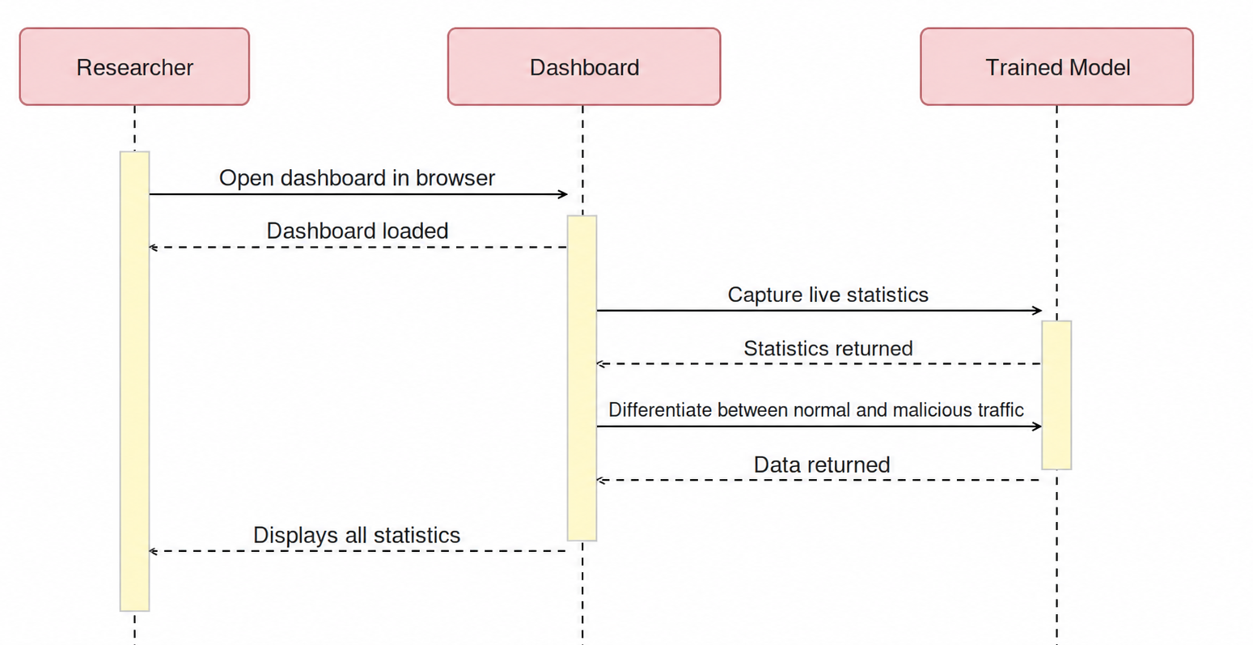
RESULTS VIA DASHBOARD

Slide 15
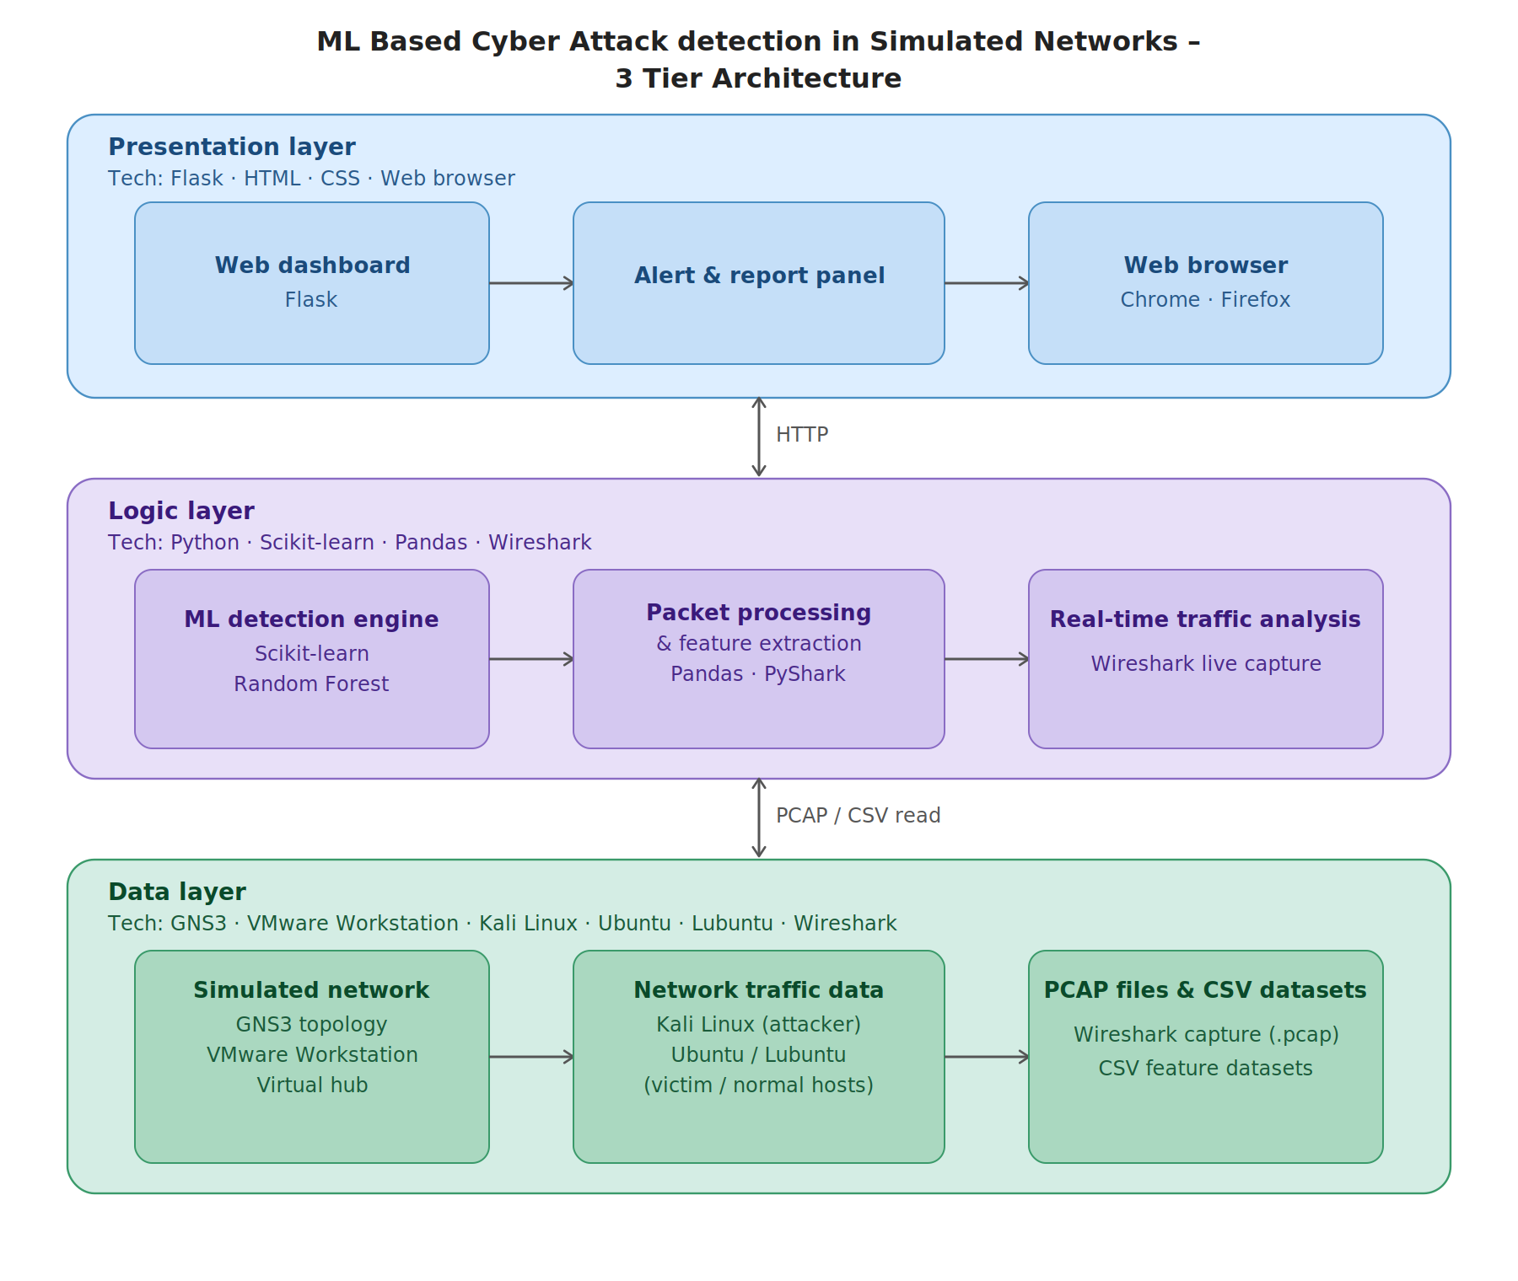
ARCHITECTURAL DESIGN

Slide 16
TEAM STRUCTURE
Rizwan Riaz Mir
Project Supervisor ┌────────────────────┴────────────────────┐
Abdullah Zubair Areeba Shafat
Configuration, Attack Generation Network Simulation &
ML training Documentation

Slide 17
TEAM STRUCTURE
Rizwan Riaz Mir
Project Supervisor
┌────────────┴────────────┐
Rizwan Riaz Mir
Project Supervisor ┌────────────────────┴────────────────────┐
Abdullah Zubair Areeba Shafat
Configuration, Attack Generation Network Simulation &
ML training Documentation
Abdullah Zubair
Configured virtual machines and project environment
Generated attack traffic for testing the detection system
Captured and processed network traffic
Performed feature extraction from packet data
Trained and tested machine learning models
Integrated the trained model with the real-time detection system
Dashboard testing and final system verification
Areeba Shafat
Planned and designed the simulated network structure
Supported network connectivity and simulation setup
Prepared the Software Requirements Specification document
Organized research material and project references
Prepared project documentation and report content
Explained project results and system workflow
Presentation preparation and final formatting

Slide 18
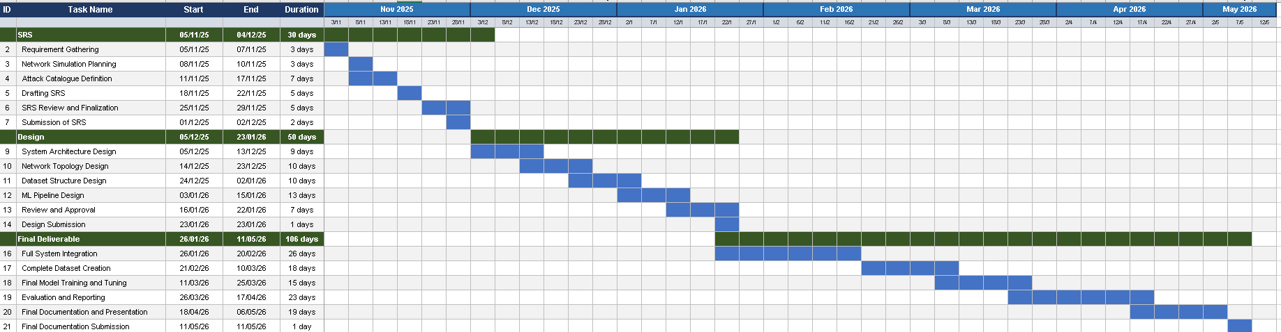
PROJECT SCHEDULE

Slide 19
TOOLS
Network Simulation
GNS3
VMware Workstation
Machine Learning Models
Random Forest
Decision Tree
SVM
KNN
Logistic Regression
Operating Systems
Kali Linux
Lubuntu
Ubuntu
Dashboard Development
Flask
HTML
CSS
Machine Learning and Data Processing
Python
Pandas
Scikit-learn
Joblib
Matplotlib
Packet Capture and Analysis
Wireshark
Scapy

